Slide 1
WOMEN
Fun time in Islam

Slide 6
Entertainment Activities for Women

Slide 12
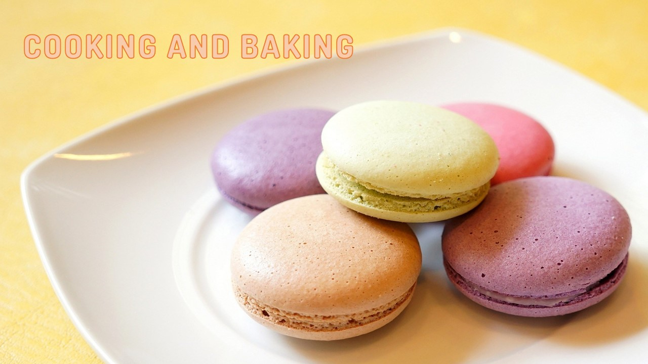

Slide 14
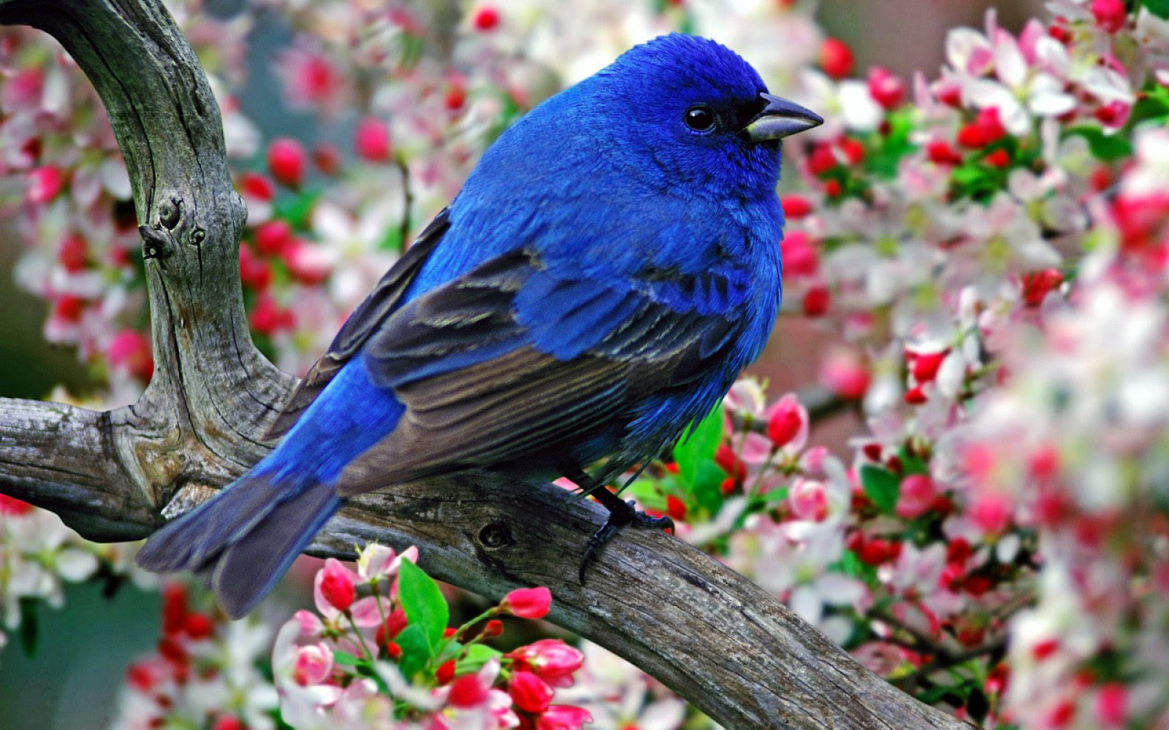
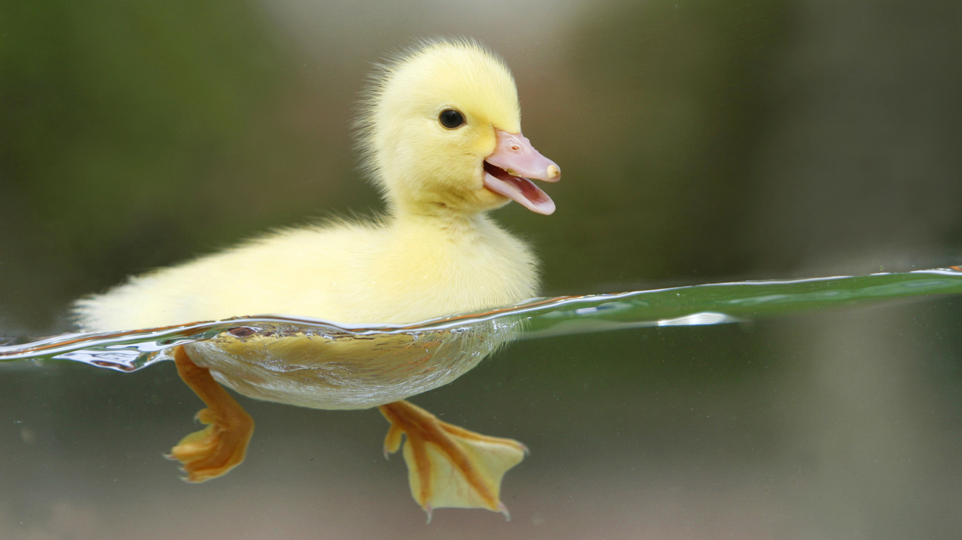
Ponder over the nature and seek relaxation into its serenity

Slide 27
So…

